Slide 1

Googl Play Stoe Apps
Presente By:
Raka Alharbi
Abdulla Alsalihi
Larana University | 2024

Slide 2
2
OVERVIEW
Exploring
Feature Engineering
Data Cleaning
Conclusion
Data Analysis
Larana University | 2024

Slide 3
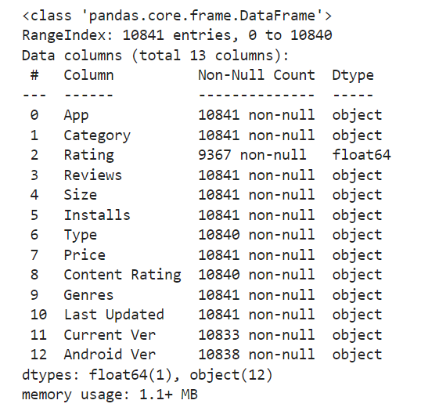
2
EXPLORING
Larana University | 2024

Slide 4
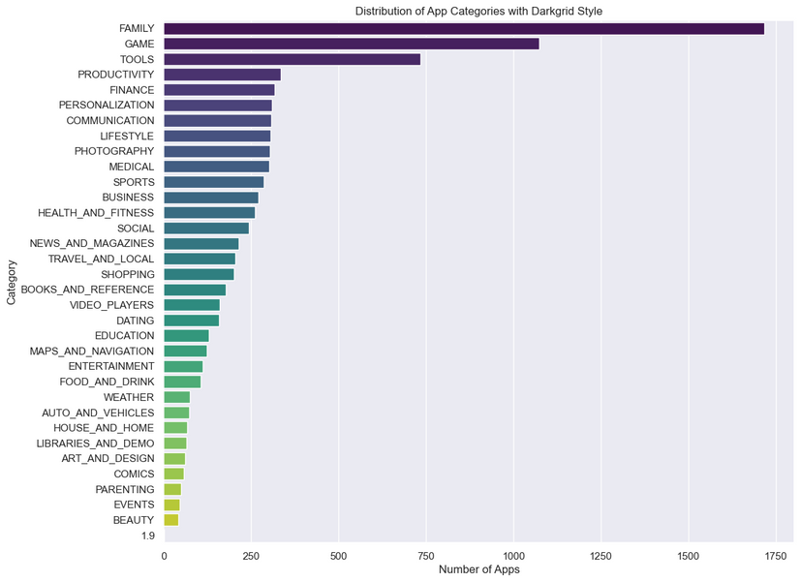
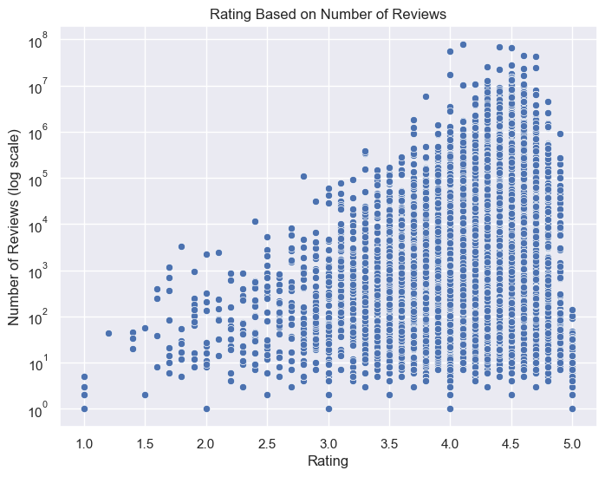
2
DATA ANALYSIS
UNIVARIATE
BIVARIATE
Larana University | 2024

Slide 5
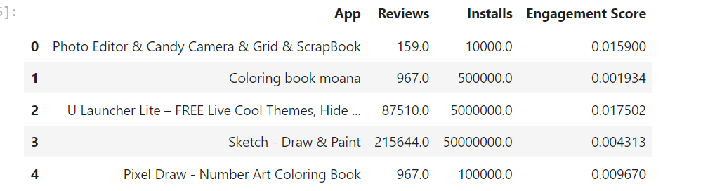
FEATURE ENGINEERING

Slide 6
5
CONCLUSION
App Categories: Most apps are Family and Games
Larana University | 2024
Feature Engineering: Engagement Score
apps with more reviews often have higher ratings

Slide 7
Larana University | 2024
THANK YOU

